Slide 1
Operating Systems

Slide 2
Overview of Operating Systems
Chapter 1

Slide 3
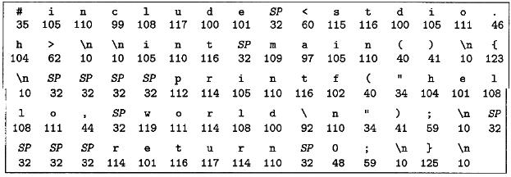
Information
Information = Bit + Context
Information is stored using binary

Slide 4

Program
Program is translated to different context
Source code is for human
Machine code is for computer
Compilation: from source code to ELF (machine code)

Slide 5
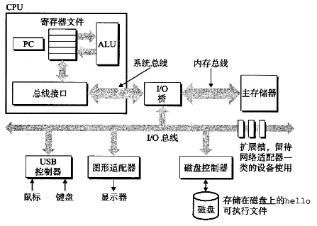
Computer Structure
Bus: transfer data to different components of hardware.
IO device: for input and output.
Memory: DRAM chip to store data temporarily.
CPU: load, store, handle, jump ELF.

Slide 6
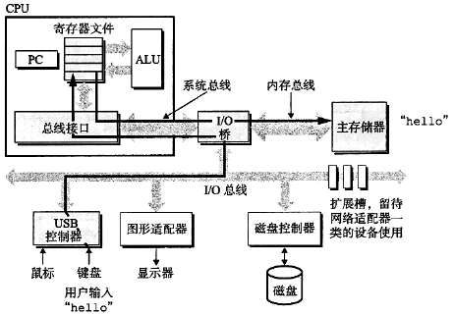
Running of Program
User input

Slide 7
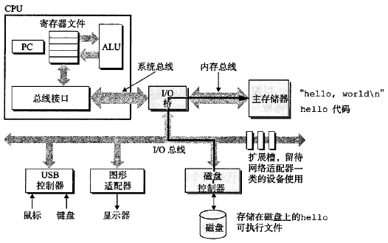
Running of Program
Load to memory

Slide 8
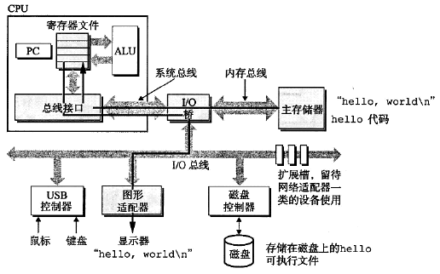
Running of Program
Processing and output

Slide 9
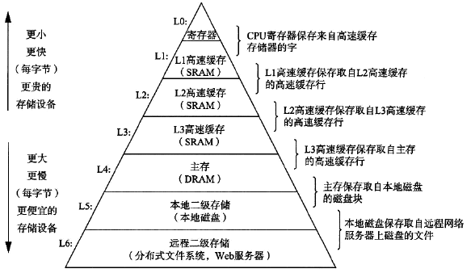
Storage Hierarchy
Faster is expensive
Trade-off between speed and cost

Slide 10

Operating Systems
OS prevents hardware to be manipulated by program.
OS offers abstract of complex hardware and drives.

Slide 11
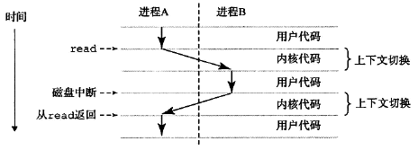
Operating Systems
Context: status of program running.
OS uses context and system call to schedule programs.

Slide 12
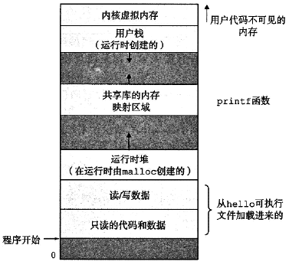
Operating Systems
Process is the minimal running unit of program.
Virtual memory is the abstract of program running.

Slide 13
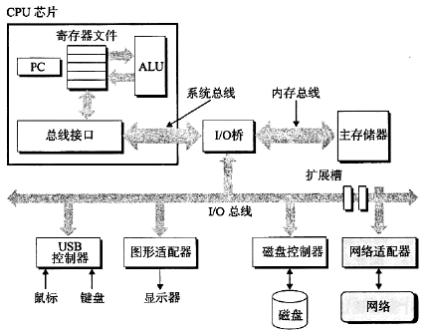
Networking
Network connects different computers.

Slide 14
Storage of Information and Program
Chapter 2

Slide 15
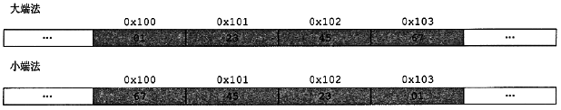
Storage of Information
Computer uses binary to store information
Each binary 0 or 1 calls a bit.
Every 8 bits calls a byte.
32 bit system: every 4 byte calls a word.
64 bit system: every 8 byte calls a word.
Each byte has an address (usually in hexadecimal).
Addressing using big-endian or little-endian.

Slide 16
Decimal
unsigned / signed: most significant bit is data or sign.
1’s complement / 2’s complement presentation.
byte: [-128, 127]
short: [-32 768, 32 767]
int: [-2 147 483 648, 2 147 483 647]
long: [-9 223 372 036 854 775 808, 9 223 372 036 854 775 807]
Overflow: result of arithmetic larger than bound.

Slide 17
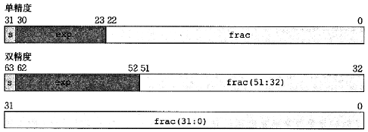
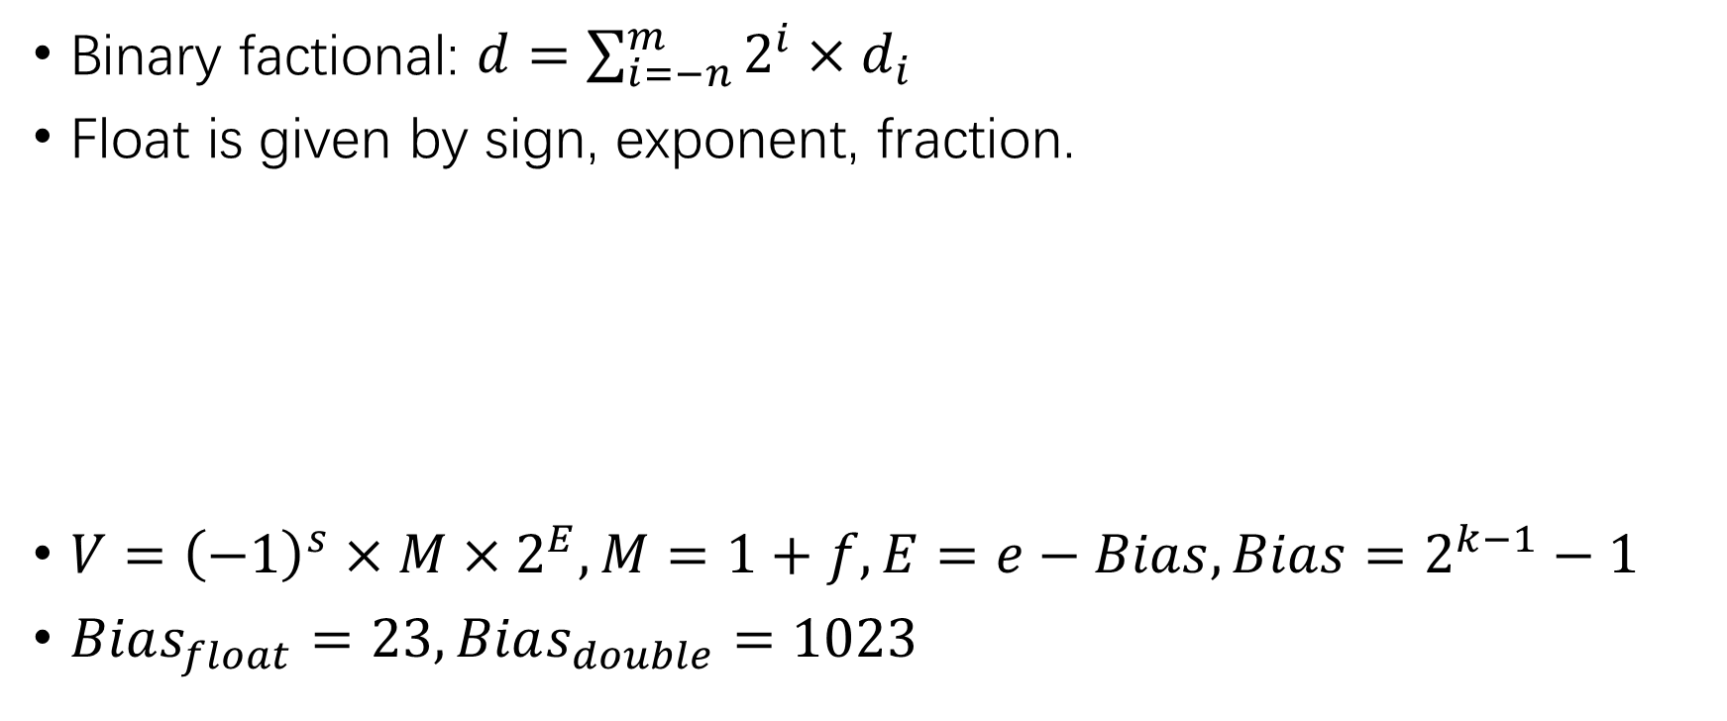
Float
Binary factional: $d=\sum_{i=−n}^{m}{2^{i}×d_{i}}$
Float is given by sign, exponent, fraction.
$V={\left(−1\right)}^{s}×M×2^{E}, M=1+f, E=e−Bias, Bias=2^{k−1}−1$
$Bias_{float}=23, Bias_{double}=1023$

Slide 18
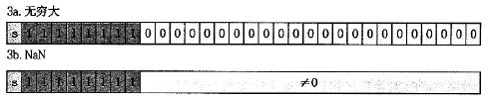
Float
Special values of float:
Float is an approximate value, sometimes round to nearest.
Float arithmetic follows the same rules of decimals.

Slide 19
Program Encoding
Assembly code (x86-64)
PC: program counter, stores the address of next instruction.
Decimal register: 16 of them, stores decimals.
State code register: perform conditional jump.
Vector register: an array of decimals or floats.
GCC is a program to compile programs.
Dis-assembler uses assembly to generate source code.

Slide 20
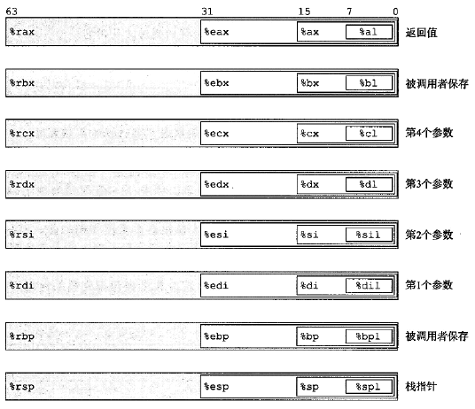
Register
%rax, %eax, %ax, %al

Slide 21
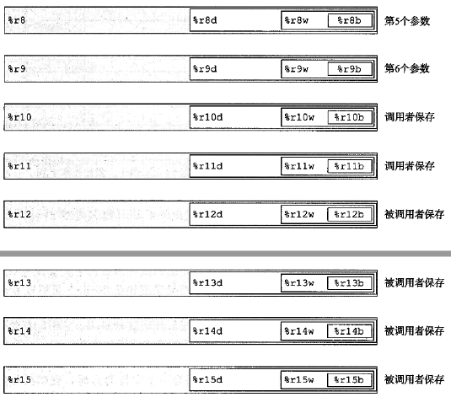
Register

Slide 22
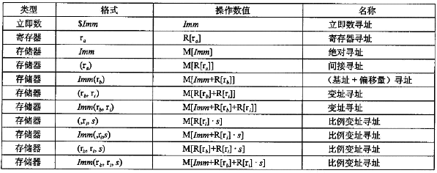
Operand
Immediate number: $0x1F $-577
Register: %rax %al
Memory address: (%rbp) 4(%rbp)

Slide 23
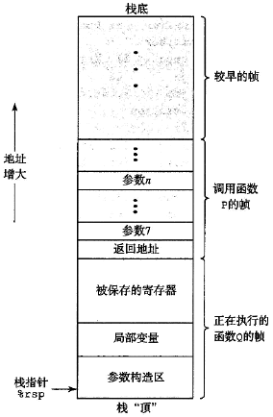
Stack
Stack is consists of stack frames.

Slide 24
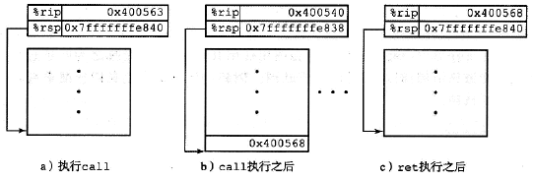
Calling Convention
Calling a function creates a new stack frame.
The information of old stack frame is stored to stack.
The return address and return value is stored in stack.

Slide 25
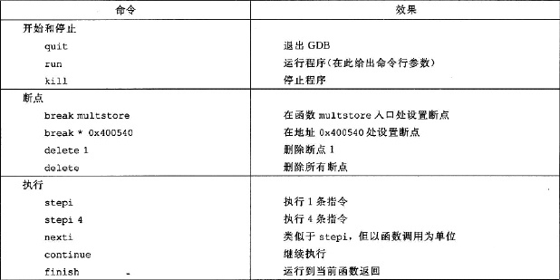
GDB Debugger
GDB debugger is used to dynamically debug program.

Slide 26
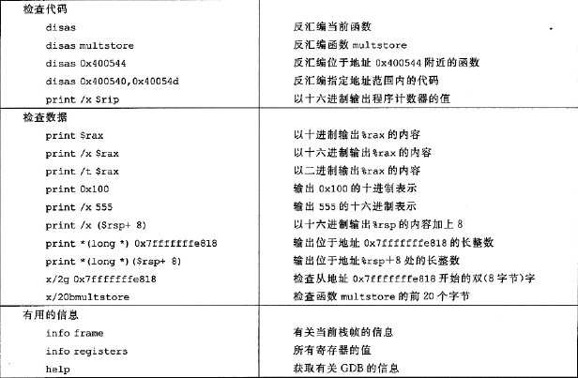
GDB Debugger

Slide 27
CPU Structure and Compiling of Program
Chapter 3

Slide 28


Logistic
Logic gate:
Combinational circuit: combination of logic gates.
Clock has rising edge and falling edge.

Slide 29
CPU Stages
Fetch: load instruction from memory.
Decode: load value from register.
Execute: ALU arithmetic & conditional.
Memory: store / load memory.
Write back: store value to register.
PC update: set PC to address of next instruction.

Slide 30
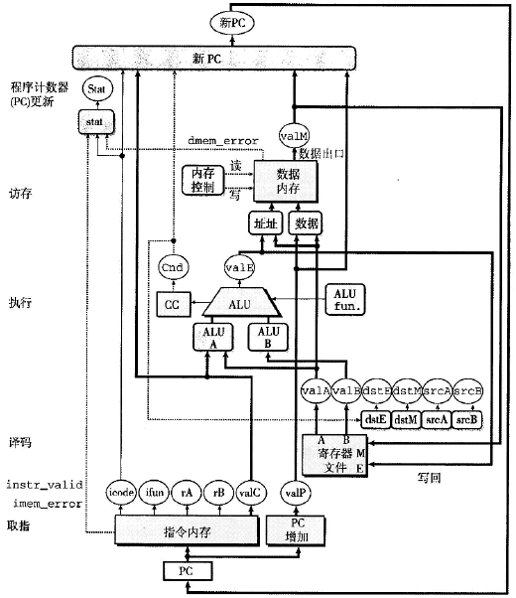
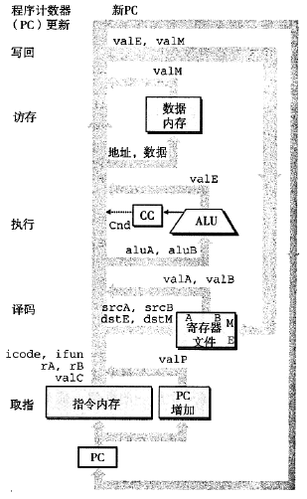
CPU Stages

Slide 31
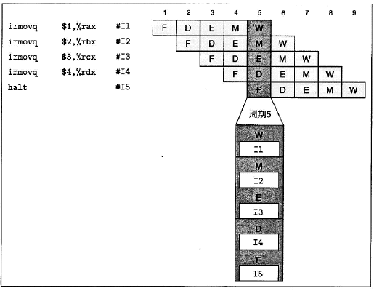
Pipeline
Estimate the next PC address / branch.

Slide 32
Program Performance
GCC (and other compilers) uses optimizer to improve performance of program.
Optimizer should be *safe*.
Dead store removal.
Using pointer may cause potential optimization problem.
Function call may cause potential optimization problem.

Slide 33
Program Performance
Remove procedure call.
Remove unnecessary memory reference.
Loop unrolling.
Improve parallel.
Branch prediction.
《代码整洁之道》
《重构：改善既有代码的设计》

Slide 34
Storage Hierarchy
Chapter 4

Slide 35
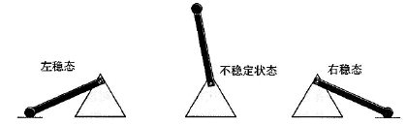
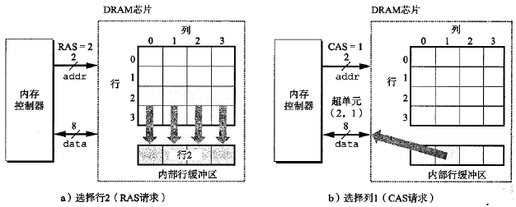
Storage
RAM: Random Access Memory.
SRAM: Static RAM.
DRAM: Dynamic RAM.
Non-volatile memory: ROM, Read Only Memory.

Slide 36
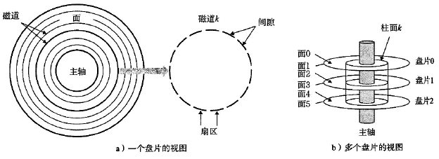
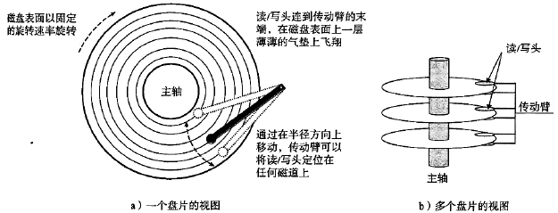
Disk
Accessing of disk using read / write head.

Slide 37
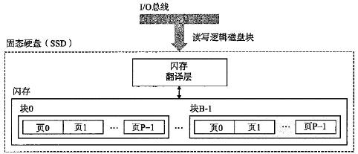
Solid State Disk, SSD
Each page is 512 bytes to 4 kb.
Read / write a whole page each time.
After r / w 100 000 times the page is broken.

Slide 38
Access Time
SRAM: 1-2 ns
DRAM: 10-20 ns
Disk: 1-5 ms
CPU: 0.1-0.5 ns
Network: ?

Slide 39
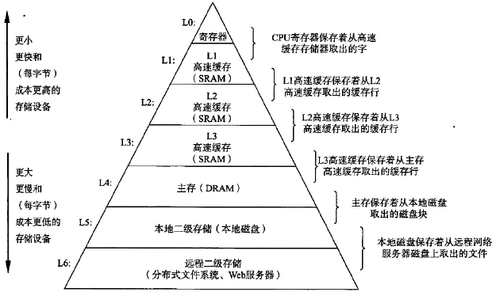
Storage Hierarchy

Slide 40
Storage Hierarchy
Cache: store frequently data in high speed storage.
Cache hit / miss.
Cache policy:
General high speed storage hierarchy.
Direct mapping cache.
Set associative cache.
Fully associative cache.
Write through vs. write back.

Slide 41
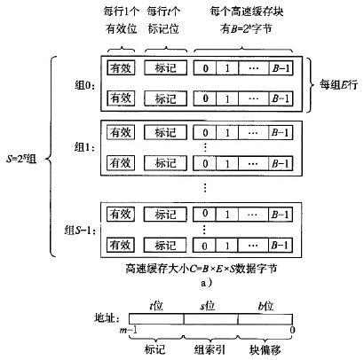
General High Speed Storage Hierarchy

Slide 42
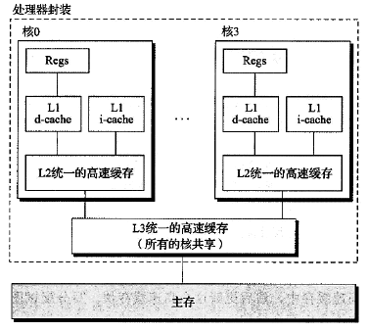
Core i7 High Speed Storage Cache

Slide 43
Running of Program
Chapter 5

Slide 44
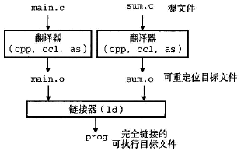
Linking
What is libc?
System functions like system(), printf(), scanf().
Static linking, symbol resolution, relocation.

Slide 45
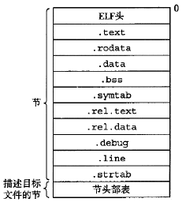
ELF
ELF structure overview:
.text: compiled machine code.
.rodata: read only data.
.data: global / static variable.
.bss: un-initialized global / static variable.
.symtab: symbol table.
.rel: related variable / function address.
.debug: debug symbol table.
.line: source code line number.
.strtab: string table.

Slide 46
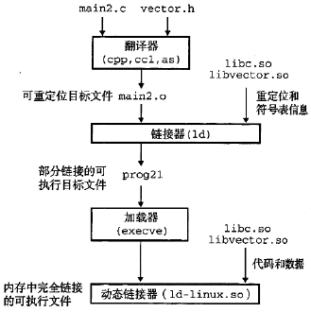
Running of Program

Slide 47
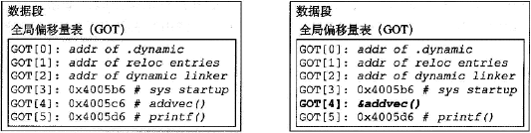
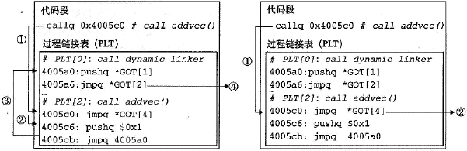
PIC, Position Independent Code
GOT, Global Offset Table: relative address to global data.
PLT, Procedure Linkage Table: code to run system function.
PLT can use GOT to locate function.

Slide 48
Exception and Interrupt Handling
Chapter 6

Slide 49
Exceptions
Interrupt: signal from I/O device.
Trap: intentional exception.
Fault: recoverable exception.
Abort: un-recoverable exception.

Slide 50
Process
Concurrency vs. parallel.
Private address space.
User mode vs. kernel mode.
Context switch.

Slide 51
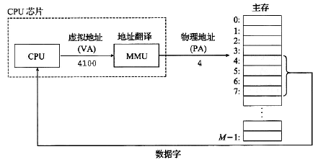
Virtual Memory Control
Virtual addressing:

Slide 52
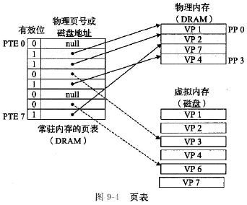
Page Table
Cache virtual memory in DRAM:

Slide 53
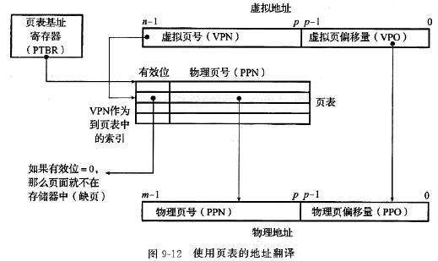
Page Table
Virtual address translation:
Multi-level page table: level-1 table points to entry in level-2.

Slide 54
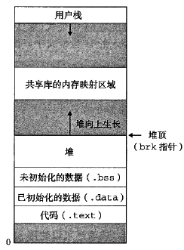
Memory Allocation
Use malloc() and free() to manage heap:
Memory fragmentation: internal, external.

Slide 55
Garbage Collection
C / C++: malloc and free manually.
Java: garbage collector.
Accessible graph.
Root graph.
Rust: no garbage collector, use memory allocation policy to control memory leak.

Slide 56
IO and Networking
Chapter 7

Slide 57
File
Linux: regular file, directory, socket.
Absolute file path: /root/flag
Relative file path: ./flag ../flag
Read / write file: file pointer, redirect.
Buffer: reduce file r / w latency.

Slide 58
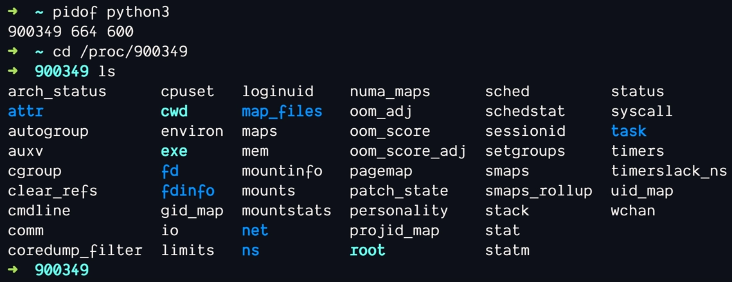
File Descriptor
Identifier for file or socket.
File descriptor vulnerability under Linux:

Slide 59

Network
Request: client to server.
Handle: server.
Response: server to client.
Handle: client.

Slide 60
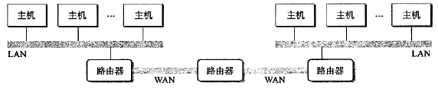
Router and Protocol
Router: connect different LANs.
Traffic on Internet follows protocols.
HTTP, HTTPS, FTP, SMB, POP3…

Slide 61
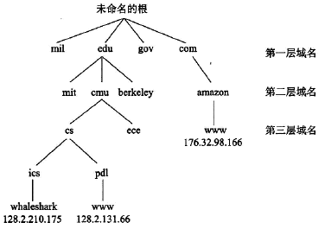
DNS
Domain name to IP address mapping.
Provided by DNS servers.
DNS pollution.

Slide 62
Summary
1. Overview of Operating Systems
2. Storage of Information and Program
3. CPU Structure and Compiling of Program
4. Storage Hierarchy
5. Running of Program
6. Exception and Interrupt Handling
7. IO and Networking

